Slide 1
Widows from around the world

Slide 2
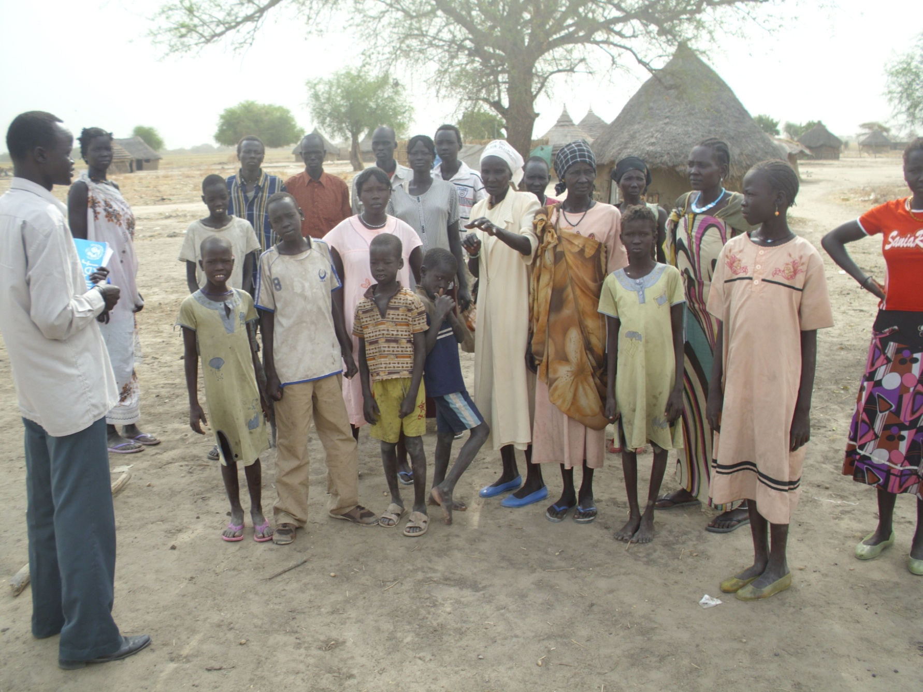
Widows and their children – Southern Sudan Slavery Fund

Slide 3
Tiger widows

Slide 4
Tiger widows

Slide 5
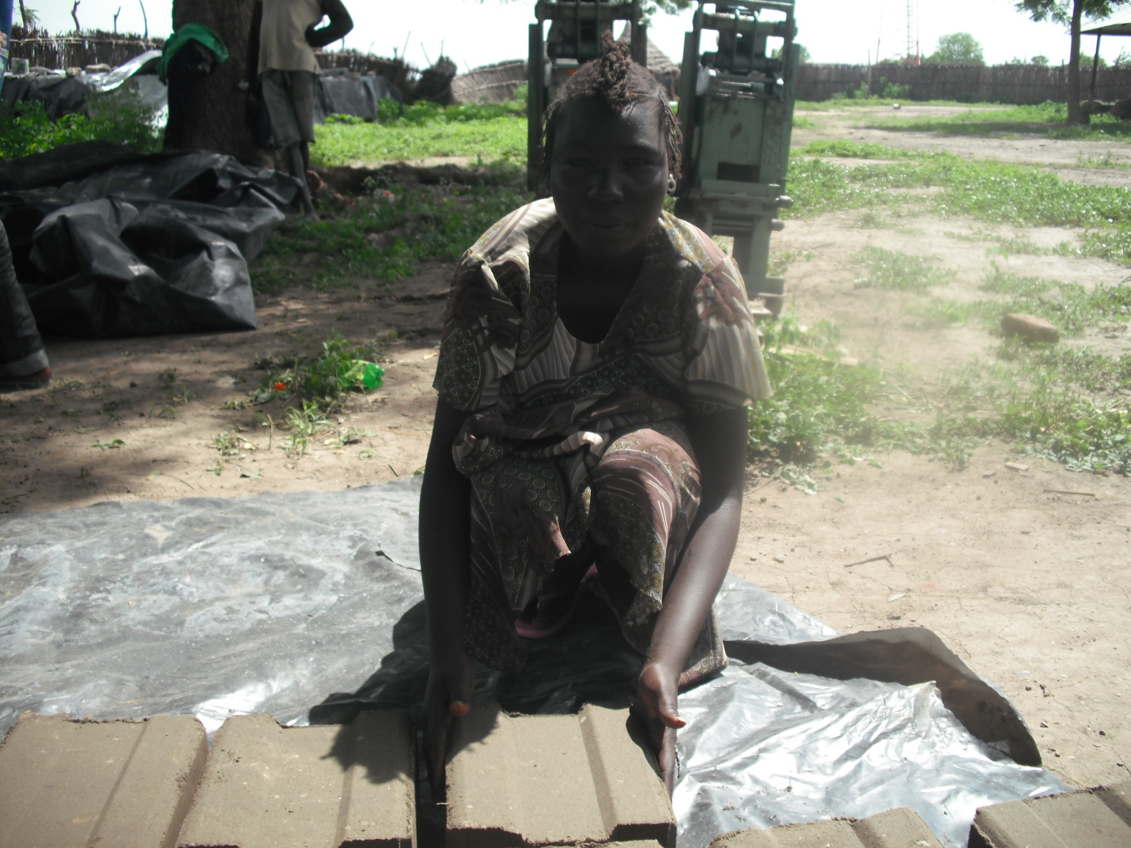
Financial independence projects – Southern Sudan Slavery Fund

Slide 6
Widows and their children – Southern Sudan Slavery Fund

Slide 7
Collecting the stories of widows – Naserian - Tanzania

Slide 8
Consulting on projects with widows – Naserian - Tanzania

Slide 9
Antonia 75, Peru spins wool HelpAge

Slide 10
Bass Bibi ,75 is a widow from Nowshera, Pakistan. Her five children have all married and moved away. She has no contact with them and they ignore her existence. HelpAge

Slide 11
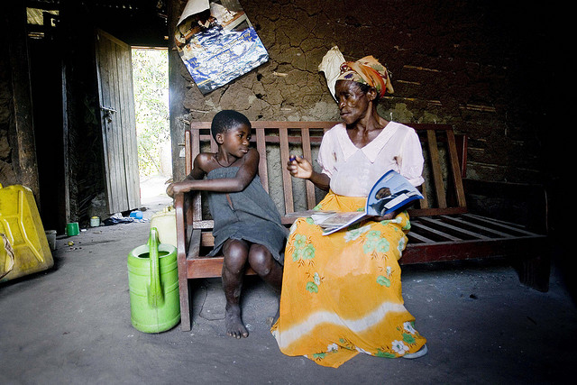
Bira, a widow living with AIDS, cares for nine orphans, Uganda HelpAge

Slide 12
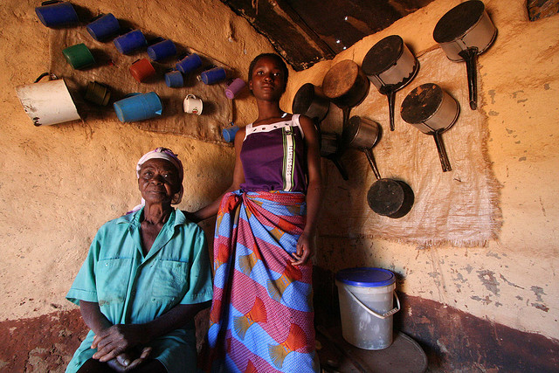
Danalia, 81, with her granddaughter in Zambia
HelpAge

Slide 13
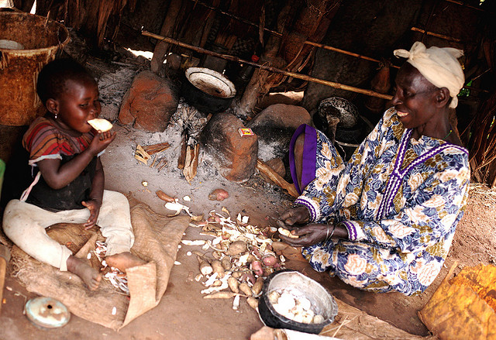
Diana, Karagwe, Tanzania looking after her grandson HelpAge

Slide 14
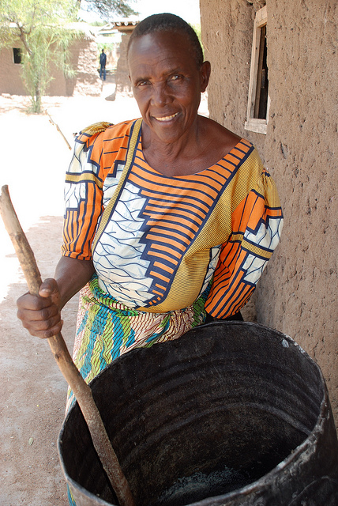
Nyamizi Tanzania HelpAge

Slide 15
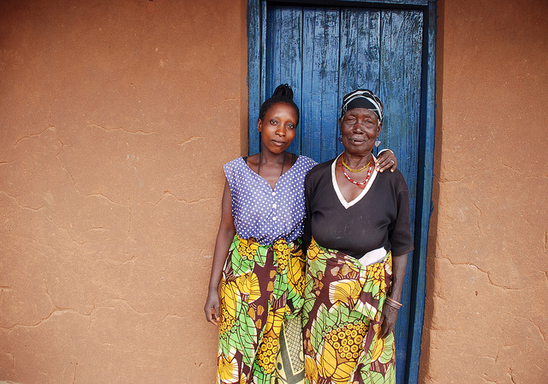
Nziku Kulwa(right) with her daughter Hawa Juma HelpAge

Slide 16
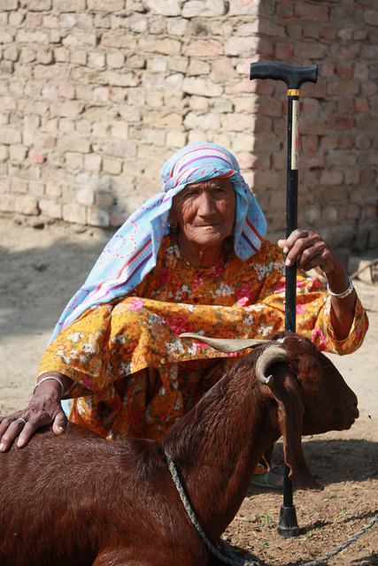
Khandzadi, 70, Pakistan HelpAge

Slide 17
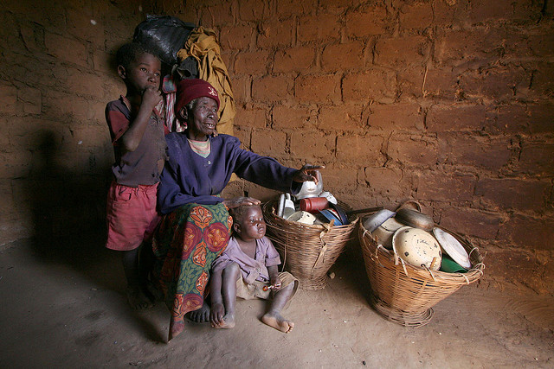
Rachel with her two grandchildren, Zambia

Slide 18
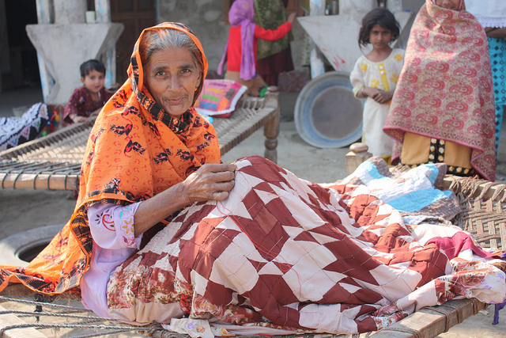
Sakina, 53, Pakistan HelpAge

Slide 19
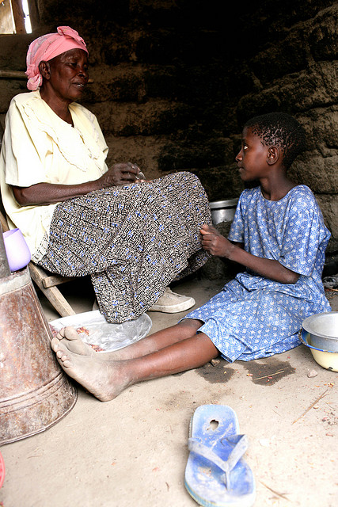
Salome with her granddaughter, Tanzania HelpAge

Slide 20
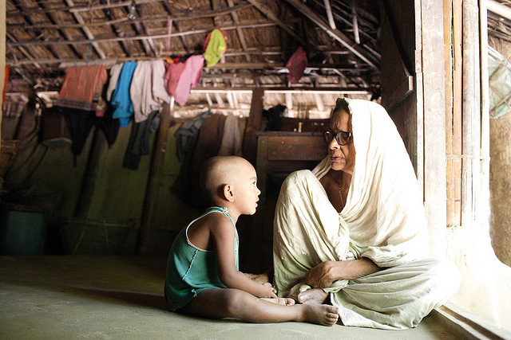
Shunda, 75 years old, looks after her grandson

Slide 21
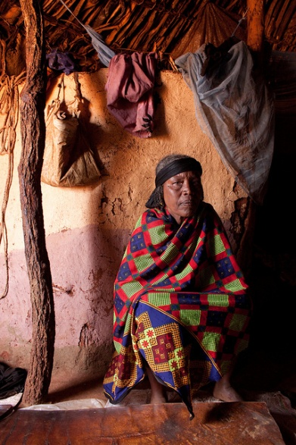
Taditi Gonjobe Shiiro, 65, moved from her village to Borana in search of food. If the drought continues, she will move to Kenya with her family

Slide 22
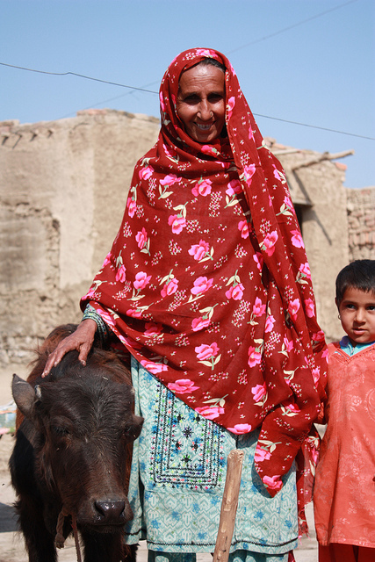
Zenul Pakistan

Slide 23
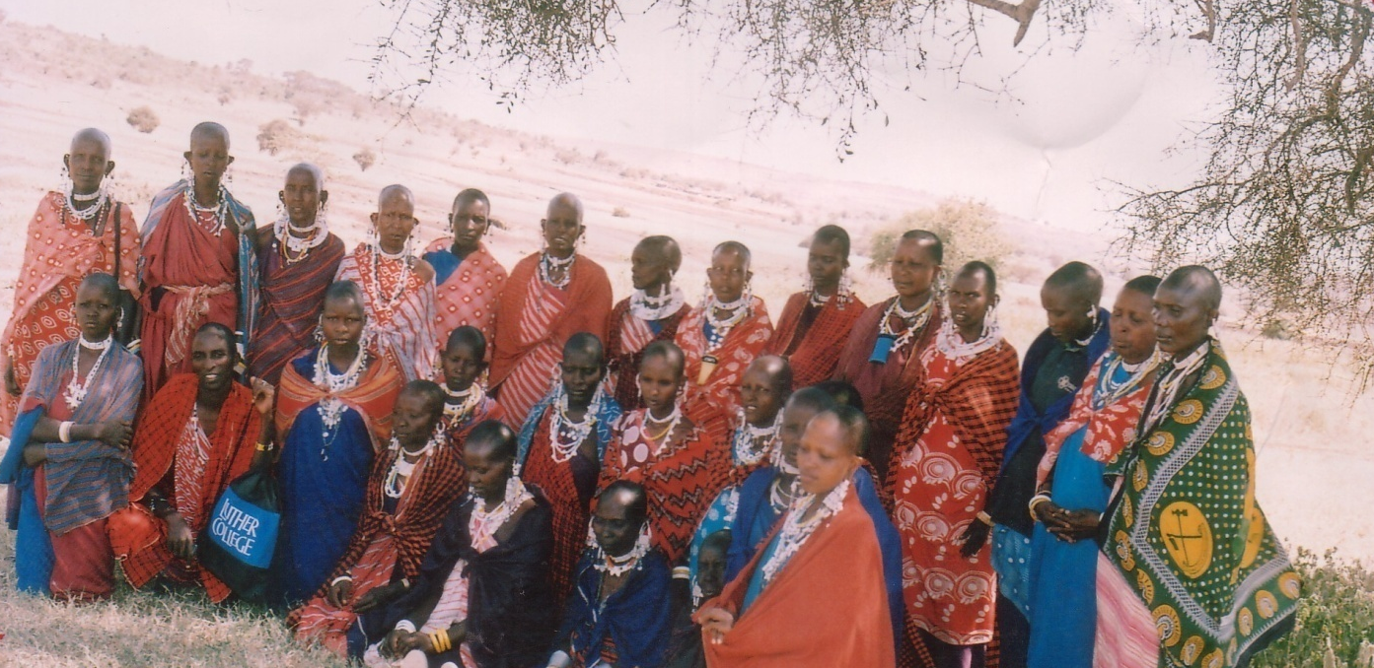
Arkaria widows committee – Naserian Tanzania

Slide 24
Meeting of widows with community elders in Lendikenya centre – Naserian Tanzania

Slide 25
Lendikenya widows committee Naserian Tanzania

Slide 26
Lendikenya widows Naserian Tanzania

Slide 27
Dancing at a widows meeting Naserian Tanzania

Slide 28
Rosa and child - Eastern Uganda

Slide 29
Widows committee Naserian Tanzania

Slide 30
Widows conference Nigeria

Slide 31
Women Alone Association - India

Slide 32
The widows of the fishermen in Nazare, Portugal

Slide 33
Widow of Vrindavan
Image: ©Tewfic El-Sawy, "White Shadows"

Slide 34
115 million of the world's widows still live in extreme poverty
Photograph: Ahmad Masood/Reuters

Slide 35
Windows for widows – employment programme

Slide 36
Window for Widows – employment programme

Slide 37
Afghanistan has the highest population of widows and orphans in Asia, according to government officials
Photo: Akmal Dawi/IRIN

Slide 38
Gomti, 20 years old when she became a widow, left with two children, 6 & 3 years old.

Slide 39
Shyampati Widow Group, Nepal 2009

Slide 40
Forty-six widows from Njewa were organized into a club to cultivate three acres of land provided for them

Slide 41
Afghani widows

Slide 42
Women at a trailer camp for widows in Baghdad celebrated a resident's remarriage WAFDI

Slide 43
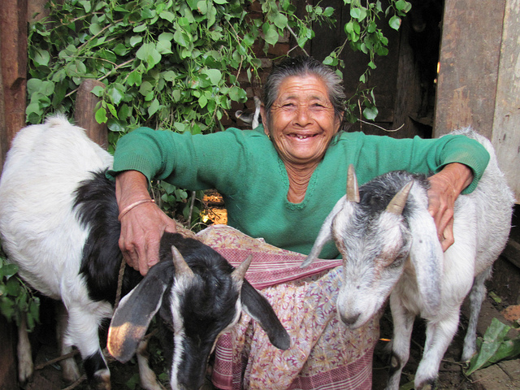
Thanks to her pension, widow Shilu, 75, can control her finances, Nepal

